Slide 1


What is cloud computing

Slide 2
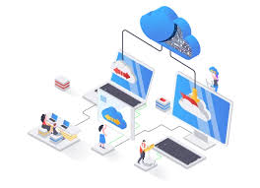
What is cloud computing…?
Think of it as renting what you need instead of owning it.
Example: Instead of buying your own storage device, you use services like Google Drive or Dropbox to store your files online and access them from anywhere.
Cloud computing works similarly but with computers, storage, and software. Instead of owning physical hardware and managing everything yourself, you rent computing power, storage, and services from companies like Amazon Web Services (AWS), Microsoft Azure, or Google Cloud.

Slide 3
Comparing traditional IT to Cloud computing
Aspect | Traditional IT 🖥️ | Cloud Computing ☁️
Infrastructure | Own servers 🏢 | Shared resources 🌎
Setup Time | Long ⏳ | Quick ⚡
Cost | High upfront 💸 | Pay-as-you-go 💳
Scalability | Limited 📏 | Flexible 📈
Maintenance | Manual 🔧 | Handled by provider 🤝
Access | On-premise 🏠 | Anywhere with internet 🌐
Disaster Recovery | Risk of data loss ⚠️ | Built-in backup 🛠️
Software Updates | Manual installation 🛠️ | Automatic updates 🔄
Energy Use | High power consumption 🔋 | Optimized by provider 🔌

Slide 4
Aspect | Traditional IT | Cloud Computing
Infrastructure | Requires physical servers, data centers, and hardware. | Uses virtual servers and shared resources over the internet.
Upfront Cost | High upfront investment for hardware, software, and setup. | Pay-as-you-go pricing with little to no upfront cost.
Scalability | Scaling requires buying and installing new hardware. | Instantly scalable up or down as needed.
Maintenance | Businesses handle hardware updates, repairs, and software. | Maintenance is handled by the cloud provider.
Accessibility | Limited to on-site access or complex VPN setups. | Accessible anywhere with an internet connection.
Deployment Time | Can take weeks or months to deploy new systems. | Services can be deployed in minutes.
Flexibility | Less flexible, tied to purchased hardware and software. | Highly flexible with a variety of services and configurations.
Disaster Recovery | Requires dedicated resources for backups and recovery plans. | Built-in disaster recovery options are often available.
Energy Efficiency | Requires energy to run and cool physical servers. | Providers optimize energy usage across shared infrastructure.
Skill Requirements | Needs in-house IT staff for maintenance and troubleshooting. | Limited in-house IT skills needed; provider manages most tasks.

Slide 5
Benefits of using cloud computing
1. Cost Savings 💰
No need for expensive hardware, physical infrastructure, or maintenance.
Pay-as-you-go model ensures you only pay for what you use.
2. Scalability 📈
Easily scale resources up or down based on demand.
Perfect for businesses with fluctuating workloads.
3. Accessibility 🌐
Access your data and applications from anywhere with an internet connection.
Encourages remote work and collaboration.
4. Performance ⚡
Cloud providers offer high-speed networks and efficient data centers.
Ensures minimal latency and maximum uptime.
5. Reliability 🤝
Built-in disaster recovery and backup solutions reduce the risk of data loss.
High availability and redundancy across servers.

Slide 6
Benefits of using cloud computing continue
6. Security 🔒
Advanced security features such as encryption, firewalls, and access controls.
Continuous monitoring to detect and prevent cyber threats.
7. Automatic Updates 🔄
Providers handle software and hardware updates, ensuring you’re always using the latest technology.
8. Environmental Benefits 🌱
Optimized resource sharing reduces energy consumption and carbon footprint.
9. Innovation 🚀
Access to advanced technologies like AI, machine learning, and big data analytics without heavy investments.
10. Flexibility 🛠️
Variety of services (e.g., storage, computing power, databases) tailored to different needs.
Multi-cloud and hybrid solutions offer more customization.

Slide 7
Types of Cloud Computing
1. Deployment Models: cloud deployment model identifies the specific type of cloud environment based on ownership, scale, and access, as well as the cloud's nature and purpose . The location of the servers you're using and who controls them are defined by a cloud deployment model.
Public Cloud
Private Cloud
Hybrid Cloud
Community Cloud
2. Service Models: cloud service models allow users or organizations to build custom software applications by providing the right ecosystem .
Infrastructure as a Service (IaaS)
Platform as a Service (PaaS)
Software as a Service (SaaS)

Slide 8
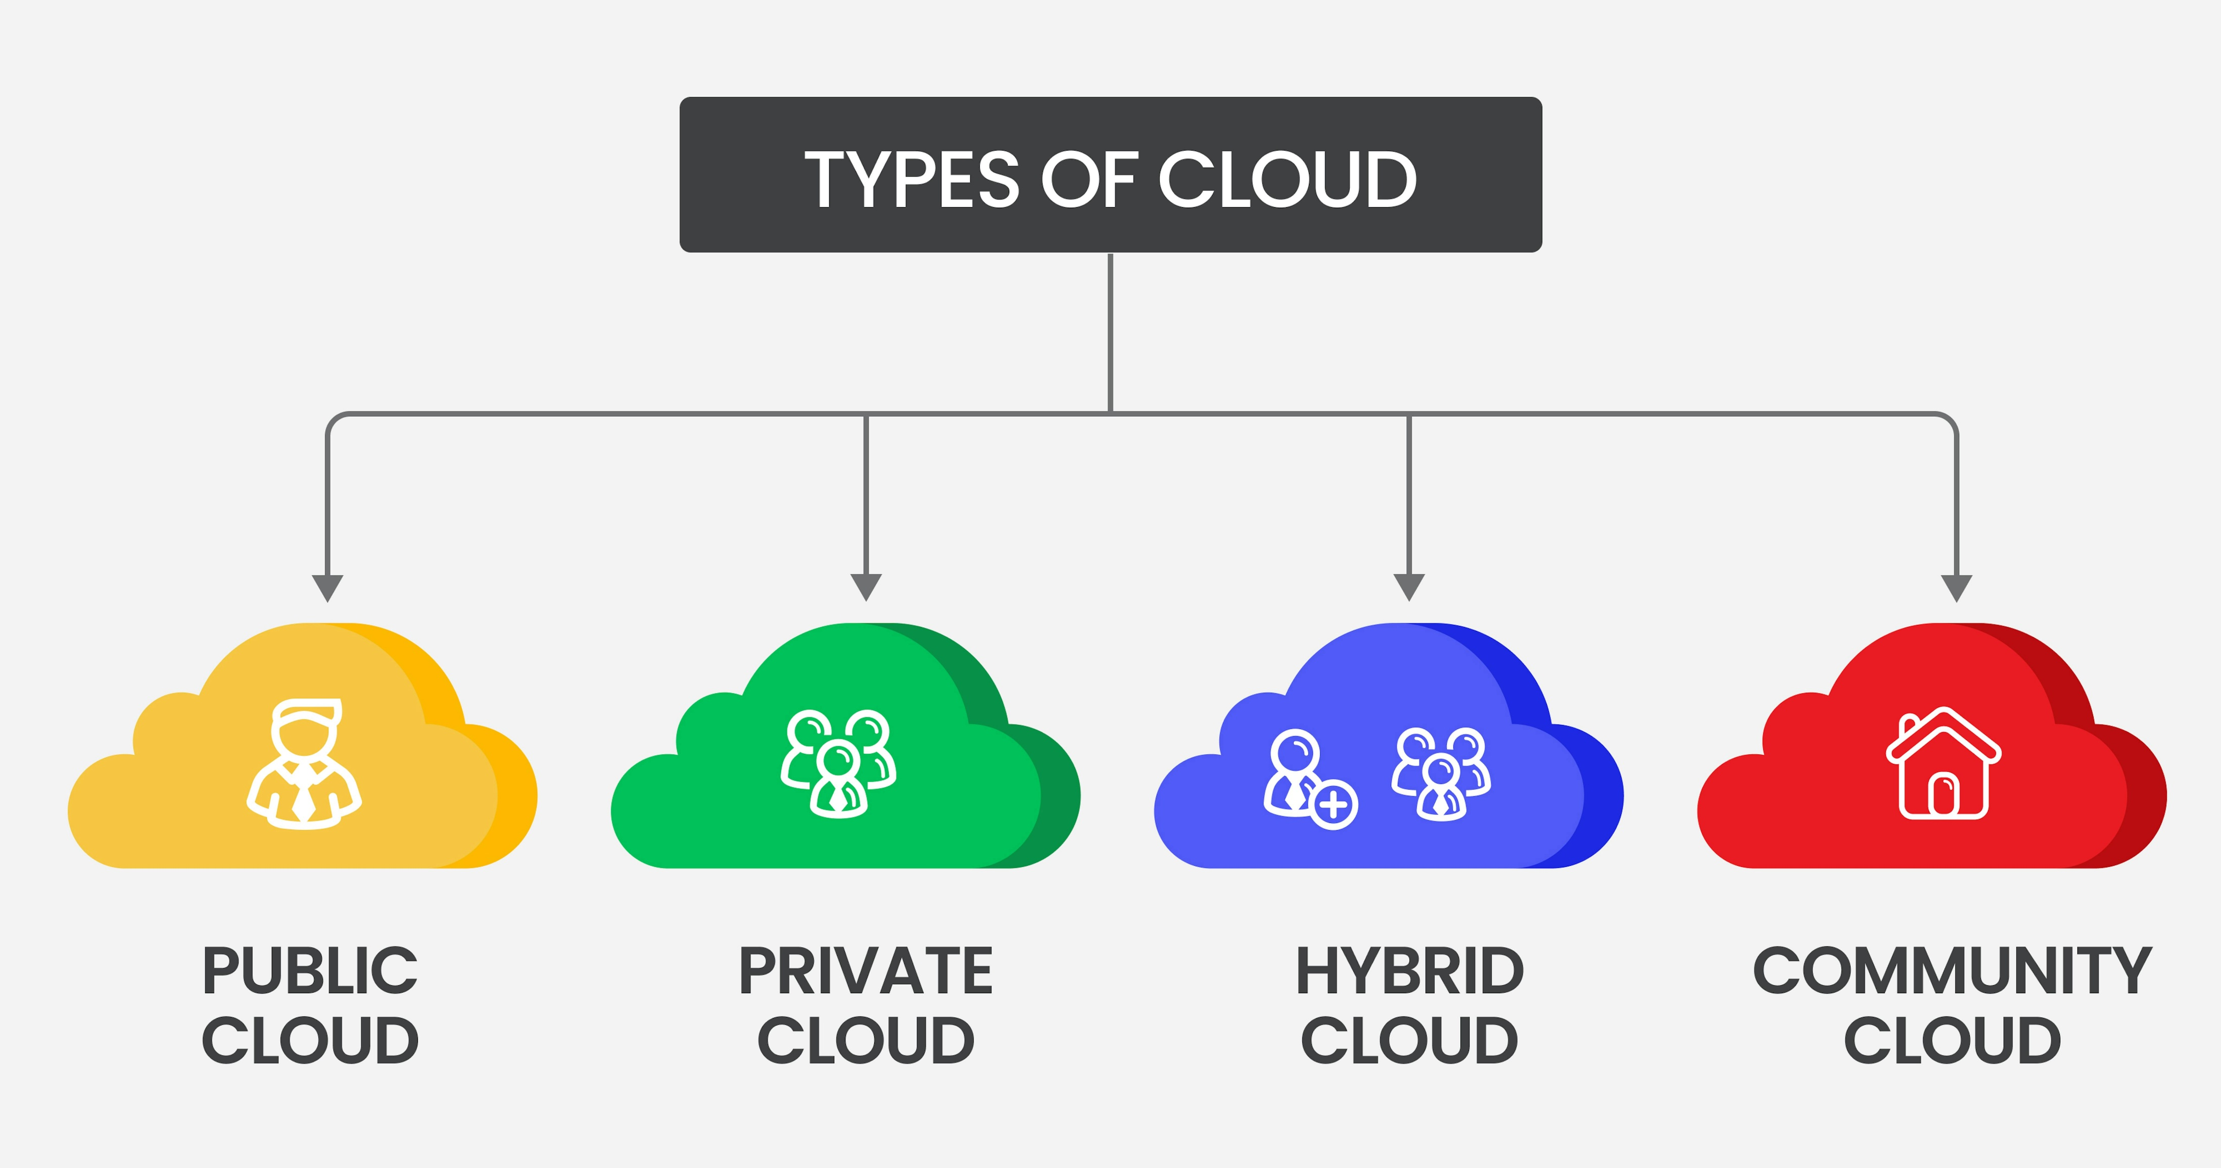
Deployment model

Slide 9
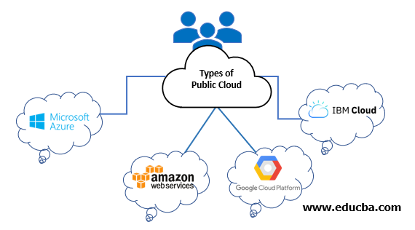
Public Cloud: Services are provided over the internet by a third-party cloud provider, and resources are shared among multiple customers.
Key Features:
Accessibility: Accessible from any internet-connected device 🌐.
Scalability: High scalability; resources can be quickly scaled up or down as needed 🔄.
Cost-Effective: Pay-as-you-go pricing model; users pay only for the resources they consume 💸.
Examples: AWS, Microsoft Azure, Google Cloud Platform.

Slide 10
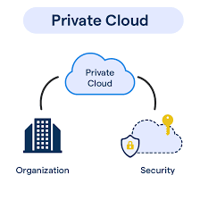
Private Cloud: A private cloud is dedicated to a single organization. It can be hosted on-premises or by a third-party provider.
Key Features:
Security: More secure as resources are dedicated solely to one organization 🔐.
Control: Greater control over the cloud environment, including security and compliance ⚙️.
Flexibility: Can be customized according to specific business needs 📊.
Examples: VMware vSphere, OpenStack.

Slide 11
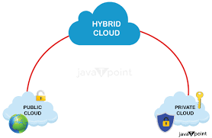
Hybrid Cloud: A combination of public and private clouds, allowing data and applications to be shared between them.
Key Features:
Flexibility: Balances scalability and control; workloads can be moved between public and private clouds based on demand 📈.
Integration: Allows existing on-premises IT resources to integrate with public cloud resources 🔗.
Data Management: Useful for companies with specific data residency requirements 📍.
Examples: Combining AWS with on-premises IT infrastructure.

Slide 12
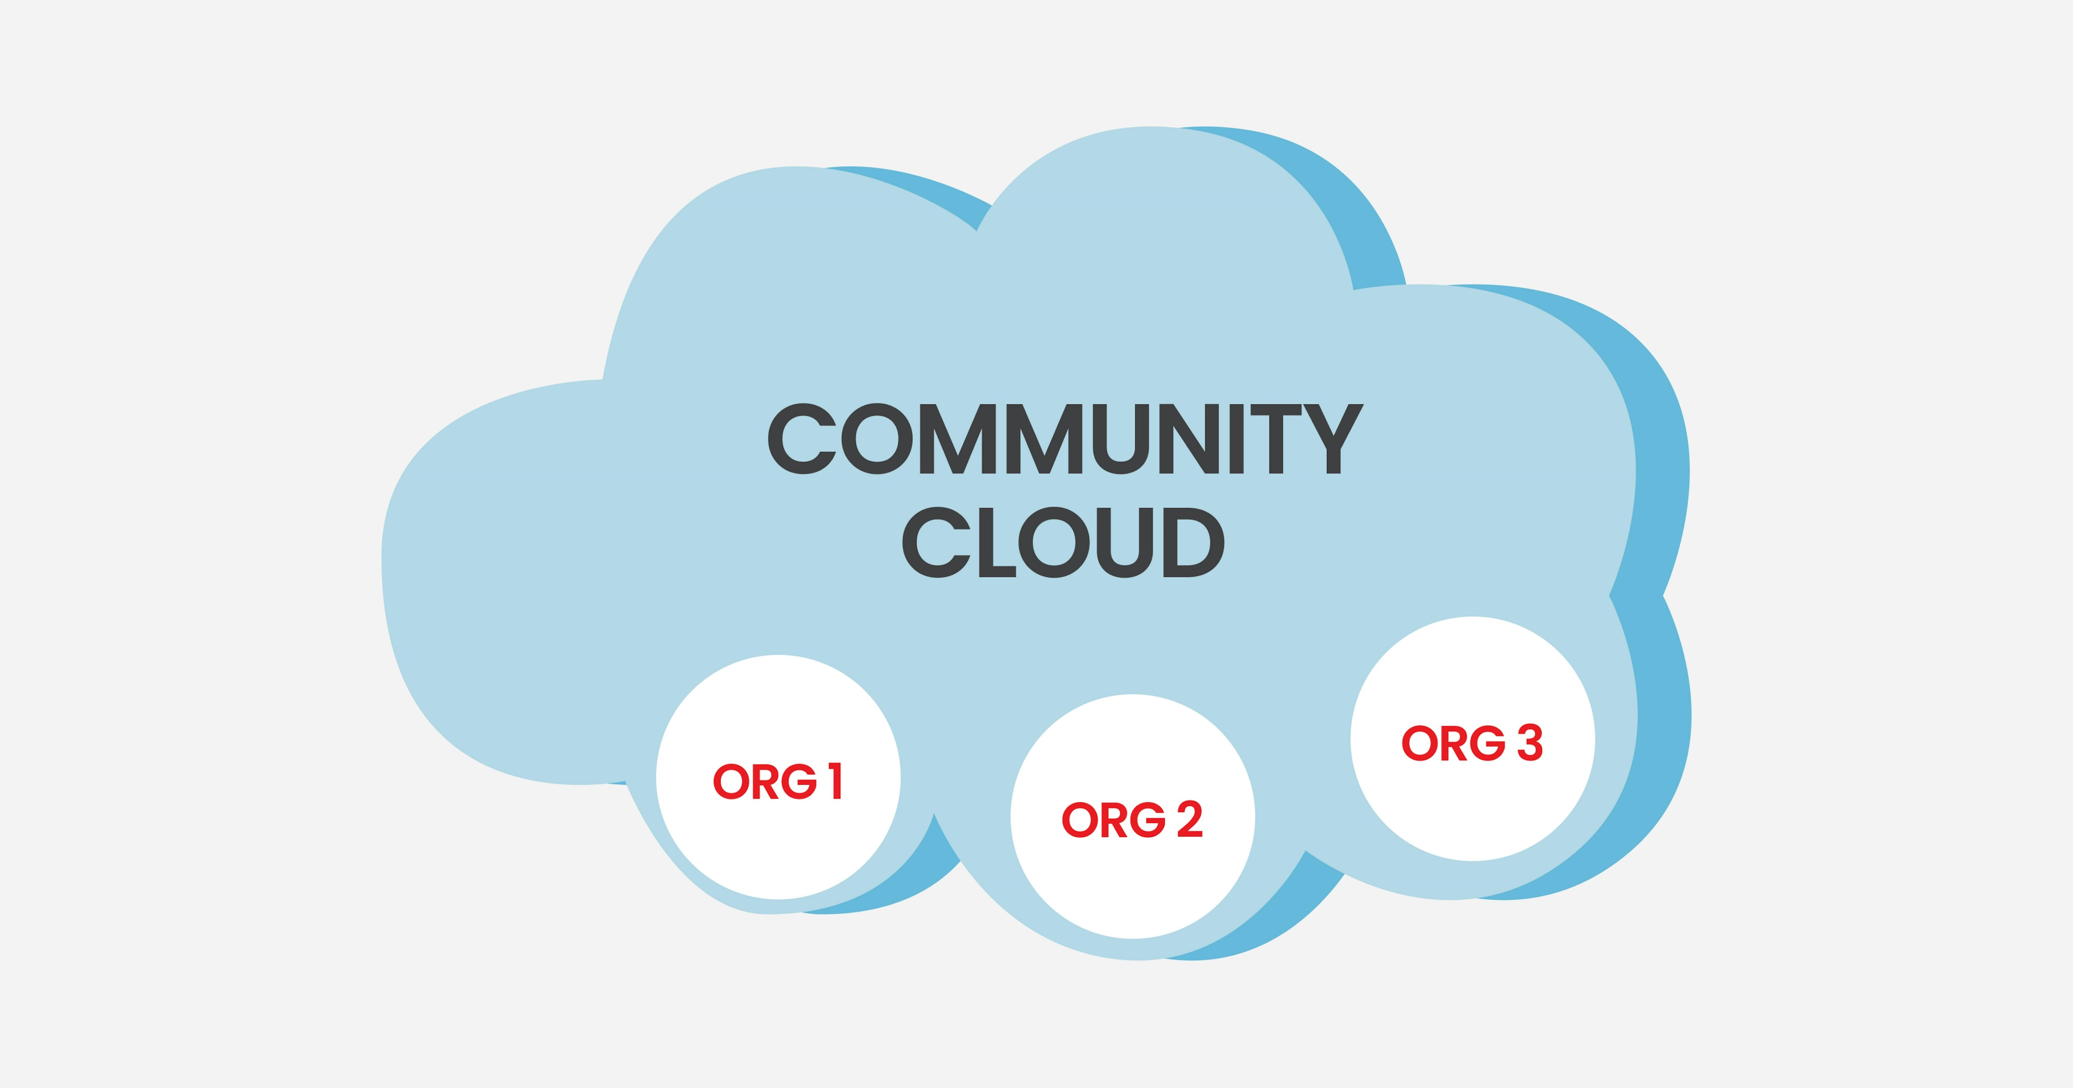
Community Cloud: Shared by several organizations with similar requirements (e.g., same industry standards).
Key Features:
Shared Goals: Cost-effective shared infrastructure for specific community use 🌐.
Security: Similar to private cloud in terms of security but shared among a group 🔒.
Compliance: Meets specific regulatory requirements for the community 📜.
Examples: A community cloud for government agencies or non-profits.

Slide 13
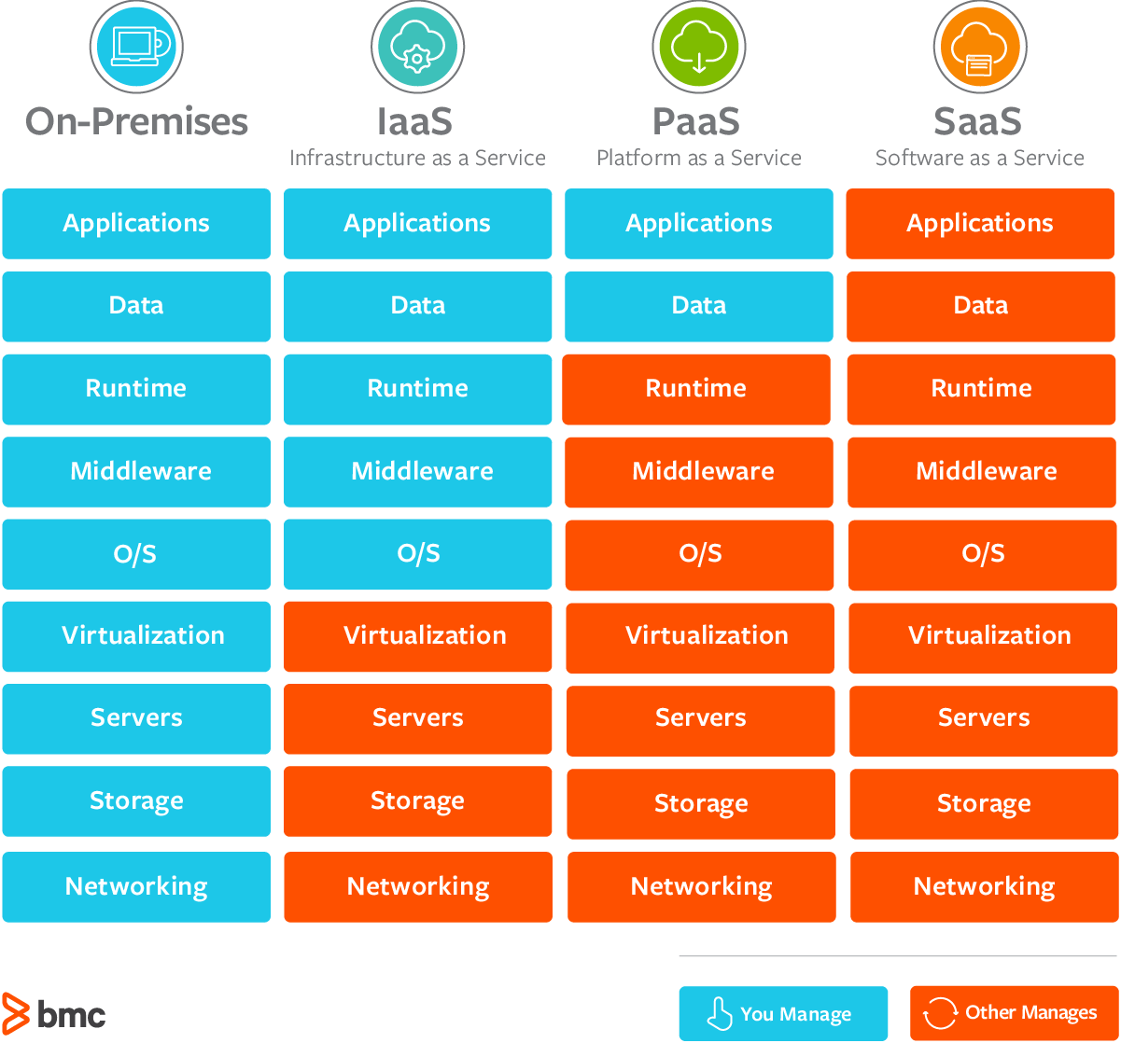
Service Models
IAAS
PAAS
SAAS

Slide 14
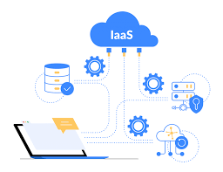
Infrastructure as a Service (IaaS): Provides virtualized computing resources over the internet. Users can rent virtual machines (VMs), storage, and networking infrastructure on an as-needed basis.
Customization: Users have control over the operating system, network configuration, and storage 🛠️.
Cost Efficiency: Pay only for the resources used 💸.
Scalability: Easily scale computing power up or down 📈.
Examples: AWS EC2, Microsoft Azure Virtual Machines, Google Compute Engine.
Imagine you want to build a new website. Instead of buying physical servers, installing operating systems, and configuring network infrastructure, you can rent these resources from a cloud provider.

Slide 15
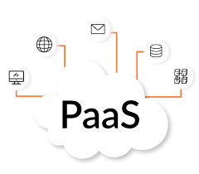
Platform as a Service (PaaS): Provides a computing platform and solution stack as a service. Users can build, run, and manage applications without dealing with the underlying infrastructure.
Development Tools: Includes development, database, and business analytics tools 🛠️.
Simplified Management: Managed environments for building applications 💼.
Scalability: Automatically scales applications 📈.
Examples: AWS Elastic Beanstalk, Microsoft Azure App Service, Google App Engine.
Imagine you're a developer wanting to build a web application. Instead of setting up servers, databases, and other infrastructure, you can use a PaaS platform to focus solely on coding your application.

Slide 16
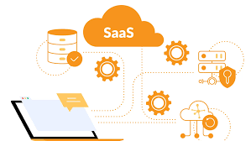
Software as a Service (SaaS): Provides software applications over the internet. The provider manages everything from infrastructure to application maintenance.
Accessibility: Accessible from any device with a web browser 🌐.
Cost-Effective: No upfront costs for software installation; subscription-based pricing 💸.
Automatic Updates: The provider handles software updates and maintenance 🔄.
Examples: Google Workspace, Microsoft 365, Salesforce.
Imagine you're a small business owner and you need a tool to manage your customer relationships, track sales, and automate marketing tasks. Instead of buying and installing software on your own computers, you can use a SaaS solution.

Slide 17
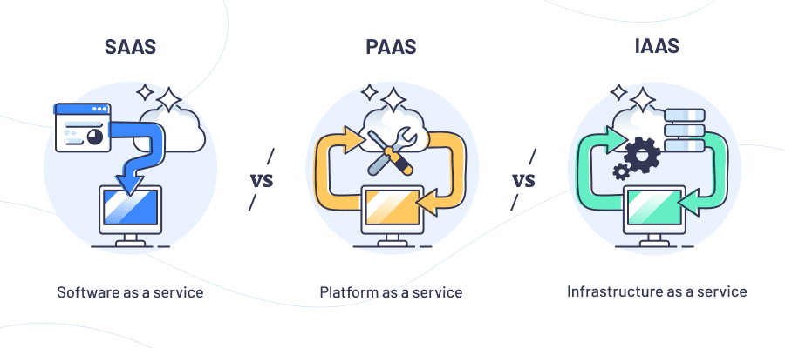
Difference between IAAS PASS SAAS

Slide 18
Feature | IaaS 🛠️ | PaaS 🚀 | SaaS 🌐
Description | Infrastructure as a Service: Rent virtualized resources like servers, storage, and networks. | Platform as a Service: Use tools to build, test, and deploy apps without managing infrastructure. | Software as a Service: Access ready-to-use applications over the internet.
Control Level | High: Full control over servers, OS, and storage. | Medium: Focus on application development, not infrastructure. | Low: Just use the application; everything else is managed.
Management | User manages OS, middleware, and runtime. | Provider manages infrastructure; user manages apps. | Provider manages everything, including maintenance and updates.
Target Users | IT administrators, developers needing flexibility. | Developers focusing on app building and testing. | End-users needing easy-to-use apps.
Examples | AWS EC2, Microsoft Azure VMs, Google Compute Engine. | AWS Elastic Beanstalk, Microsoft Azure App Service, Google App Engine. | Google Workspace, Microsoft 365, Salesforce.
Use Case | Hosting websites, data storage, disaster recovery. | Building and deploying custom apps. | Email, CRM, collaborative tools.
Setup Complexity | High 🛠️ | Medium ⚙️ | Low ✅

Slide 19
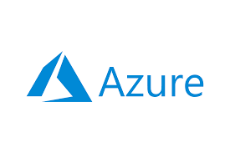

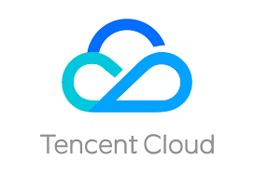
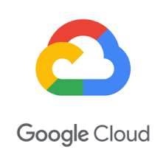
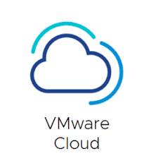
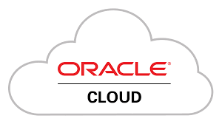
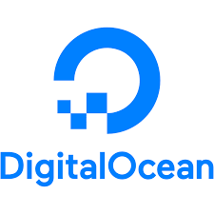
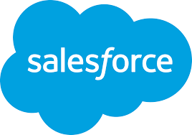
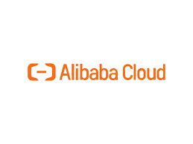
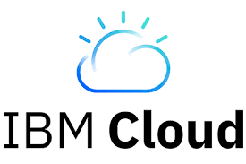
Popular cloud service providers globally

Slide 20
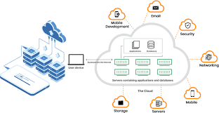
How Cloud Computing Works…?
Front End: Users interact with the cloud using web browsers, mobile apps, or other interfaces.
Back End: Data and applications are stored and processed on powerful servers located in data centers around the world.
Internet: Acts as the bridge that connects the front end to the back end.

Slide 21
Let’s see few AWS Services ….

Slide 22
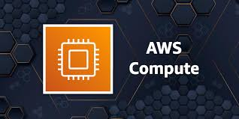
Let’s see few AWS Services ….
1. Compute Services:
AWS provides scalable and flexible compute power.
Amazon EC2: Virtual servers in the cloud for running applications.
AWS Lambda: Serverless computing to run code in response to events.
Amazon Elastic Beanstalk: Simplified application deployment and management.
Amazon ECS/EKS: Managed container services for running Docker and Kubernetes workloads.
AWS Batch: Batch processing of large-scale jobs.

Slide 23
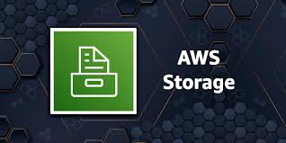
2. Storage Services
AWS offers a variety of storage solutions for different use cases.
Amazon S3: Scalable object storage for data backup and archival.
Amazon EBS: Block storage volumes for EC2 instances.
Amazon FSx: Managed file storage for Windows and Lustre.
Amazon Glacier: Low-cost storage for long-term archiving.
AWS Storage Gateway: Hybrid storage integration between on-premises and cloud.

Slide 24
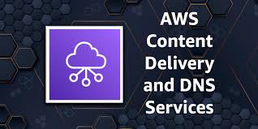
3. Networking and Content Delivery
Networking tools enable secure and fast data transfer.
Amazon VPC: Virtual Private Cloud for isolated networking.
AWS Direct Connect: Dedicated network connection to AWS.
Amazon CloudFront: Content Delivery Network (CDN) for faster content delivery.
Elastic Load Balancing: Distributes traffic across multiple instances.
AWS Route 53: Scalable Domain Name System (DNS).

Slide 25
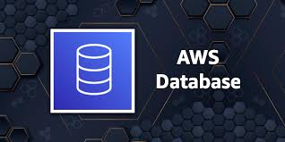
4. Database Services
AWS provides managed databases for relational, non-relational, and analytics workloads.
Amazon RDS: Managed relational database (MySQL, PostgreSQL, etc.).
Amazon Aurora: High-performance relational database engine.
Amazon DynamoDB: NoSQL database for key-value and document data.
Amazon Redshift: Data warehouse for analytics.
Amazon ElastiCache: In-memory caching for Redis and Memcached.

Slide 26
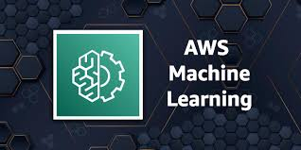
5. Machine Learning and AI
AWS offers pre-built and custom ML and AI tools.
Amazon SageMaker: Build, train, and deploy ML models.
AWS Rekognition: Image and video analysis (e.g., object and face recognition).
Amazon Polly: Converts text into lifelike speech.
Amazon Lex: Build conversational chatbots.
Amazon Forecast: Time-series forecasting.

Slide 27
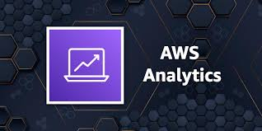
6. Analytics
Services for big data processing and analytics.
Amazon EMR: Big data processing using Hadoop and Spark.
Amazon Athena: Query data in S3 using SQL.
AWS Glue: Data integration and ETL service.
Amazon Kinesis: Real-time data streaming and analytics.
Amazon QuickSight: Business intelligence and data visualization.

Slide 28

7. Security and Identity
AWS provides tools for securing data and managing access.
AWS IAM: Manage access and permissions for AWS services.
AWS WAF: Web application firewall to protect web apps.
Amazon GuardDuty: Threat detection for AWS accounts.
AWS Shield: Protection against DDoS attacks.
AWS KMS: Managed encryption key storage.

Slide 29
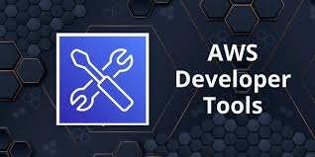
8. Developer Tools
AWS supports DevOps practices with developer tools.
AWS CodePipeline: Continuous integration and deployment (CI/CD).
AWS CodeCommit: Secure Git-based repositories.
AWS CodeBuild: Build and test code in the cloud.
AWS Cloud9: Cloud-based integrated development environment (IDE).

Slide 30
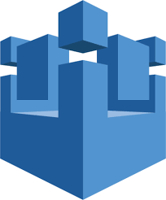
9. Internet of Things (IoT)
AWS offers IoT services for managing connected devices.
AWS IoT Core: Connect and manage IoT devices securely.
AWS Greengrass: Local computing and data management for IoT devices.
AWS IoT Analytics: Analyze IoT data at scale.

Slide 31
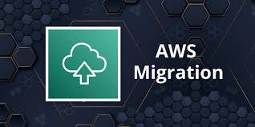
10. Migration and Transfer
AWS supports migration of applications and data to the cloud.
AWS Migration Hub: Centralized tracking for migrations.
AWS Snowball/Snowmobile: Physical devices for transferring large datasets.
AWS Database Migration Service: Migrate databases to AWS.

Slide 32
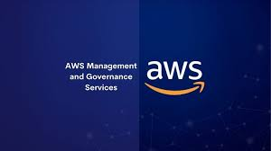
11. Management and Governance
Services to monitor, manage, and optimize AWS usage.
AWS CloudWatch: Monitoring for AWS resources and applications.
AWS CloudTrail: Logs and tracks user activity and API calls.
AWS Config: Resource inventory and compliance auditing.
AWS Auto Scaling: Automatically adjust resources to demand.

Slide 33
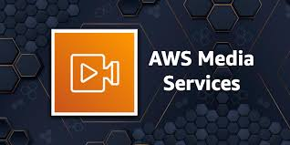
12. Media Services
AWS provides tools for creating, processing, and distributing media content.
AWS Elemental MediaLive: Live video processing and delivery.
AWS Elemental MediaConvert: File-based video transcoding.
Amazon IVS: Interactive video streaming.

Slide 34
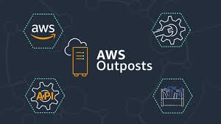
13. Hybrid Cloud
AWS enables integration with on-premises environments.
AWS Outposts: AWS services in on-premises data centers.
AWS ECS Anywhere: Run containers on local hardware.
AWS Backup: Unified backup management for hybrid environments.

Slide 35
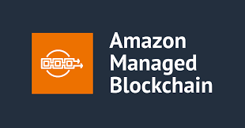
14. Blockchain
AWS supports blockchain development and management.
Amazon Managed Blockchain: Build and manage blockchain networks.
Amazon Quantum Ledger Database (QLDB): Immutable, transparent, and cryptographically verifiable ledger database.

Slide 36

15. Game Development
AWS offers solutions for building and hosting games.
Amazon GameLift: Scalable game server hosting.
AWS Lumberyard: Free game engine integrated with AWS.

Slide 37
How to create AWS free tire account
1. Visit the AWS Sign-Up Page
Open your web browser and navigate to the official AWS sign-up page: https://aws.amazon.com/resources/create-account/
2. Enter Your Email Address and Account Name
Provide your email address and choose a name for your AWS account.
Click "Verify Email Address."
3. Verify Your Email
Check your email inbox for a verification code from AWS.
Enter the code on the AWS sign-up page and click "Verify."
4. Set Your Root User Password
Create a strong and secure password for your root user account.
Confirm the password and click "Continue."
5. Select Account Type
Choose "Personal - for your own projects."

Slide 38
6. Provide Personal Information
Enter your full name, contact number, country, and address.
Click "Continue."
7. Enter Billing Information
Enter your credit card or debit card details.
Important: The AWS Free Tier does not require you to pay for most services within the first 12 months, but you will need to provide valid payment information.
8. Verify and Continue
Review the information you've entered and click "Verify and Continue."
9. Select Support Plan
Choose "Basic Support - Free."
10. Confirm Account Creation
Click "Continue" to complete the account creation process.

Slide 39
Important Notes:
Free Tier Limitations: The AWS Free Tier has limitations on the usage of various services. Refer to the official AWS Free Tier documentation for detailed information: https://aws.amazon.com/free/
Account Security: After creating your account, it's crucial to implement strong security measures, such as:
Multi-Factor Authentication (MFA): Enable MFA for your root user and other important accounts.
IAM Users: Create and use IAM users with limited privileges for day-to-day operations instead of the root user.
Regular Security Reviews: Regularly review your AWS account for any unauthorized activity.

Slide 40
Let’s get started with AWS Services ….

Slide 41

What is Data-center..?
A data center is a facility that houses an organization's IT infrastructure, including servers, storage systems, networking equipment, and other computing resources. It is designed to store, manage, and distribute data while ensuring security, reliability, and performance. Data centers are critical for running applications, hosting websites, managing databases, and enabling cloud computing services.

Slide 42
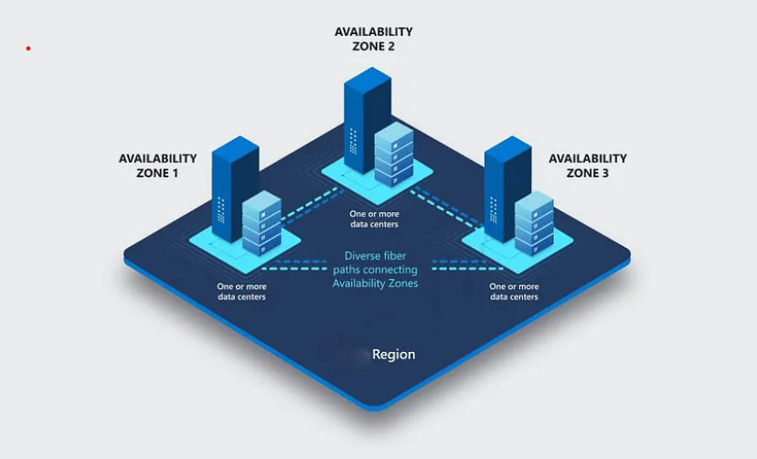
Region: A Region is a geographical area where AWS has multiple data centers. Each region is designed to operate independently and contains multiple isolated locations called Availability Zones.
Global Coverage: AWS has multiple regions around the world (e.g., us-east-1 in Virginia, USA, and eu-west-1 in Ireland).
Isolation: Each region is isolated to ensure fault tolerance and stability, so issues in one region don't affect others.
Data Residency: Allows customers to store data close to their users for better performance and to meet regulatory or compliance requirements.
Service Availability: Not all AWS services are available in every region, so you must choose a region that supports the services you need.
Example:
Region Name: us-east-1
Location: Northern Virginia, USA

Slide 43
Availability Zone (AZ):
An Availability Zone is one or more physically distinct data centers within a region. These data centers have independent power, cooling, and networking but are connected with low-latency, high-speed networks to enable seamless failover.
High Availability: Using multiple AZs helps build fault-tolerant and highly available applications.
Isolation: AZs are isolated from one another to minimize the impact of failures (like power outages) in one AZ.
Connected: AZs in a region are connected with high-speed, redundant, low-latency networks, making it easy to replicate data or distribute workloads.
Naming Convention: AZs are named with a letter suffix, such as us-east-1a, us-east-1b, etc.
Example:
In the us-east-1 region:
AZs: us-east-1a, us-east-1b, us-east-1c

Slide 44
Relationship Between Region and AZ
A region contains two or more Availability Zones.
Example:
Region: us-west-2 (Oregon)
Availability Zones: us-west-2a, us-west-2b, us-west-2c
Why Use Regions and AZs?
Regions:
Choose a region close to your users to reduce latency.
Meet regulatory or compliance requirements (e.g., storing data within a specific country).
Availability Zones:
Distribute your applications across multiple AZs to ensure high availability.
Protect against data center failures.

Slide 45
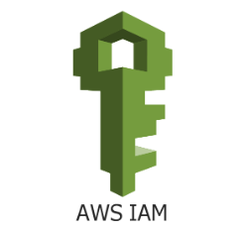
Identity and Access Management (IAM)
Identity and Access Management (IAM) is a foundational service in Amazon Web Services that helps securely manage access to AWS resources. It allows you to control who is authenticated (signed in) and authorized (has permissions) to use resources within your AWS account.

Slide 46
Features of AWS IAM
IAM Users: Represents individual users (e.g., employees, contractors) who need access to AWS resources.
Each user can have a unique set of credentials (username/password, access keys).
Password policies can be enforced for security.
IAM Groups: Logical collections of IAM users.
Simplifies permission management by attaching policies to a group instead of individual users.
IAM Policies: Documents (written in JSON) that define permissions.
Managed Policies: Created and maintained by AWS or you.
Inline Policies: Embedded directly in a user, group, or role.
IAM Roles: Assigned to entities (AWS services, users, or applications) for temporary access.
Used in scenarios like EC2 accessing S3 or Lambda invoking another service.

Slide 47
Basic Structure of a Policy: A policy is written in JSON and includes
Version: Specifies the policy language version. (The latest is "2012-10-17")
Statement: One or more statements defining the permissions.
Effect: Specifies whether the action is allowed or denied.
"Allow": Grants permission.
"Deny": Explicitly denies permission (overrides allow).
Action: Defines the specific AWS service operations the policy allows or denies.
Format: "service:operation".
Use "*" to specify all actions for a service.
Resource: Specifies the AWS resource(s) to which the policy applies.
Format: Amazon Resource Name (ARN).
Use "*" to apply to all resources.
{
"Version": "2012-10-17",
"Statement": [
{
"Effect": "Allow",
"Action": "s3:ListBucket",
"Resource": "arn:aws:s3:::example-bucket"
}
]
}

Slide 48
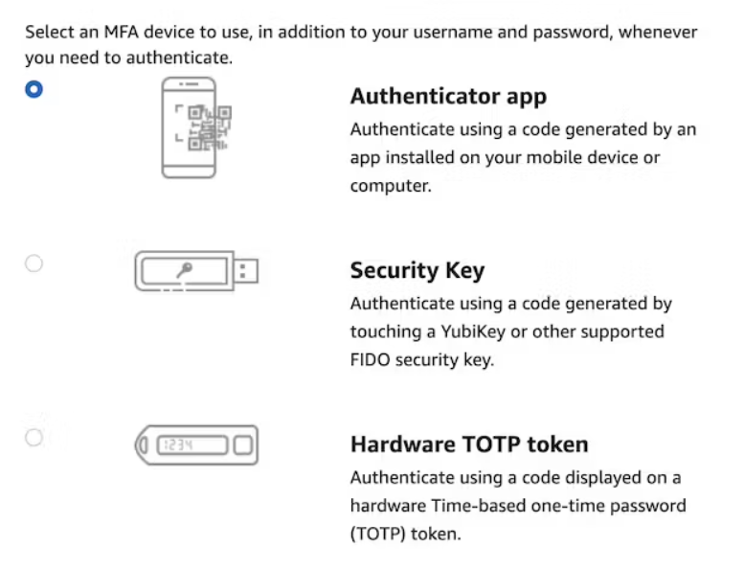
What Is Multi-Factor Authentication
Multi-Factor Authentication (or short MFA) adds another layer of security to any authentication mechanism.
Importance of MFA at AWS
As said in the introduction, with great power comes great responsibility. Your AWS is one of your most significant responsibilities as a compromised account can ruin your financial future in a short time frame.
MFA is one major security layer to prevent account compromise. And it comes for free and with low effort.

Slide 49
You can access AWS services through several methods:
1. Management Console:
Suitable for beginners and occasional users who prefer a visual interface. Log in to the AWS Management Console to access the web interface for AWS services. (protected by password + MFA)
2. AWS CLI:
Ideal for automation, scripting, and advanced users who prefer command-line interaction. Install the AWS CLI for scripting and interacting with AWS services directly from your terminal. protected by access key
3. AWS SDKs:
Best for developers building applications that interact with AWS services. Use AWS SDKs for programming languages like Python (Boto3), Java, Node.js, etc.
For example, install Boto3 in Python:
pip install boto3
4. AWS Tools for Visual Studio Code: Convenient for developers using Visual Studio Code.
5. AWS CloudShell: A handy option for quick tasks and those who prefer a cloud-based environment.

Slide 50
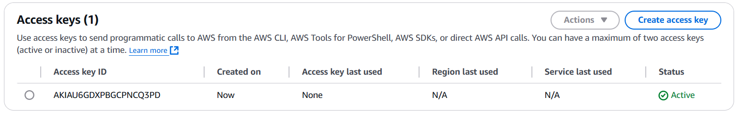
How Access Key Looks: Don’t share them

Slide 51
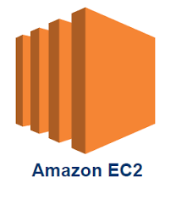
Amazon EC2 (Elastic Compute Cloud)
Amazon EC2 is a core service in AWS that provides scalable virtual servers in the cloud. It enables users to run applications on virtual machines (instances) without worrying about physical hardware.
It mainly consists in the capability of :
• Renting virtual machines (EC2)
• Storing data on virtual drives (EBS)
• Distributing load across machines (ELB)
• Scaling the services using an auto-scaling group (ASG)

Slide 52
Launching an EC2 Instance (Steps)
Login to AWS Console.
Navigate to the EC2 Dashboard.
Click Launch Instance.
Choose an AMI (e.g., Amazon Linux, Windows Server, etc.).
Select an Instance Type.
Configure instance details (e.g., VPC, user data scripts).
Add storage (EBS volumes).
Configure Security Groups.
Review and launch the instance.
Access the instance using SSH or RDP.

Slide 53
Instance Types: An instance type in Amazon EC2 defines the underlying hardware and performance characteristics of an EC2 instance. It specifies the CPU, memory, storage, and networking capacity available to the instance, allowing you to choose the configuration that best fits your application's requirements.
1. General Purpose: Balanced compute, memory, and network (e.g., t2.micro, m5.large).
Use Case: Web servers, development environments.
2. Compute Optimized: High-performance CPUs (e.g., c5.large).
Use Case: Machine learning, gaming servers.
3. Memory Optimized: Large amounts of memory (e.g., r5.large).
Use Case: In-memory databases.
4. Storage Optimized: High-performance storage (e.g., i3.large).
Use Case: Data warehousing, Hadoop.
5. Accelerated Computing: GPU or FPGA for specialized workloads (e.g., p4d).
Use Case: Machine learning, video processing.

Slide 54
Instance Type Naming Convention
Instance types are identified using a naming scheme like m5.large.
Instance Family: Defines the primary use case, e.g., m for general purpose, c for compute-optimized.
Generation: Indicates the version of the instance type, e.g., 5 for the fifth generation.
Size: Specifies the allocation of resources. Examples include small, medium, large, xlarge, and 2xlarge (double the resources of xlarge).

Slide 55
Pricing Models
On-Demand Instances: Pay per second or hour with no long-term commitment. Flexible but costlier than other options.
Reserved Instances: Commit to a 1- or 3-year term for significant cost savings.
Spot Instances: Bid for unused EC2 capacity. Cost-effective but instances can be terminated if your bid price is outbid.
Savings Plans: Flexible pricing based on consistent usage commitment.
Dedicated Hosts/Instances: Run on hardware dedicated to you. Useful for compliance and licensing.

Slide 56
Key pair(login): In EC2 is a set of security credentials used to log in to an Amazon EC2 instance securely. The key pair consists of two parts:
Public Key: This part is stored on the EC2 instance. AWS associates this public key with the instance when it's launched.
Private Key: This part is downloaded and stored locally on your computer. It's used to securely authenticate and connect to the instance via SSH (for Linux) or RDP (for Windows).
Security Group in Amazon EC2 acts as a virtual firewall that controls inbound and outbound traffic for your EC2 instances. It plays a critical role in securing your instances by allowing or denying traffic based on specified rules.
Inbound Rules: Define which incoming traffic is allowed to reach the instance.
Example: Allow SSH (port 22) from a specific IP range.
Outbound Rules: Define which outgoing traffic is allowed from the instance.
Example: Allow all outbound traffic to access the internet.

Slide 57
User Data in Amazon EC2 allows you to run scripts or pass configuration information to an instance at the time it is launched. This is particularly useful for automating initial configuration tasks, such as installing software, configuring settings, or setting up an application.
#!/bin/bash
sudo su
yum update -y
yum install -y httpd
systemctl start httpd
systemctl enable httpd
echo "<html><body><h1>Web Server Content</h1></body></html>" | sudo tee /var/www/html/index.html

Slide 58
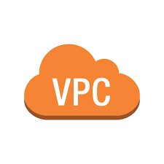
Virtual Private Cloud (VPC) in Amazon Web Services (AWS) is a logically isolated network environment within the AWS cloud. It enables users to launch AWS resources, such as EC2 instances, in a virtual network that they define. VPCs provide full control over networking, including IP address ranges, subnets, routing tables, and security configurations.
Example Use Case: Suppose you're running a web application with the following components
A front-end web server
A back-end application server
A database
Without a VPC:
All resources are on the public internet, exposing them to potential attacks.
Limited control over traffic flow and network segmentation.
With a VPC Architecture:
Create a VPC with two subnets:
Public Subnet: For web servers accessible via the internet.
Private Subnet: For back-end servers and databases.
Use an internet gateway to allow public access to the web server.
Use a NAT gateway for private subnet resources to access the internet securely.

Slide 59
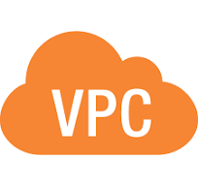
You can have multiple VPCs in an AWS region (max. 5 per region — soft limit)
Max. CIDR per VPC is 5, for each CIDR:
Min. size is /28 (16 IP addresses)
Max. size is / 16 (65536 IP addresses)
Because VPC is private, only the Private IPv4 ranges are allowed:
10.0.0.0 - 10.255.255.255 (10.0.0.0/8)
172.16.0.0- 172.31.255.255 (172.160.0/12)
192.1680.0 - 192.1 68255.255 (192.168.0.0/16)
Your VPC CIDR should NOT overlap with your other networks (e.g., corporate)

Slide 60
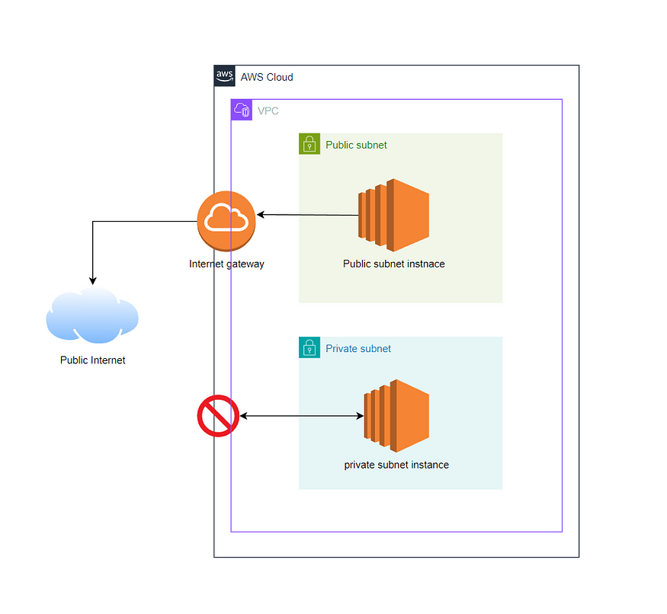
Subnets are subdivisions of a VPC that allow you to segment the network further. Each subnet is associated with a particular Availability Zone (AZ) in a region.
Public Subnets are exposed to the internet, typically containing resources that need internet access (like web servers).
Private Subnets are isolated from the internet, ideal for internal resources like databases.

Slide 61
How AWS Reserves IPs in a Subnet
AWS reserves the first 5 IP addresses and the last 1 IP address in every subnet for internal use
.0: Network address
.1: Reserved by AWS for the VPC router
.2: Reserved for DNS
.3: Reserved for future use
.255: Broadcast address (not supported in VPC)
For example, in 10.0.1.0/24, the usable range is 10.0.1.4 to 10.0.1.254.

Slide 62

Route Table:
A route table contains a set of rules (routes) that dictate where network traffic from a subnet should go.
Each subnet is associated with a route table, which directs the traffic within the VPC and to external networks like the internet or on-premises data centers.

Slide 63
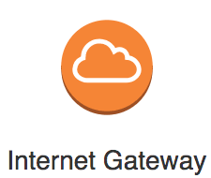
Internet Gateway (IGW):
An IGW is required to allow resources in a VPC’s public subnet to communicate with the internet.
An IGW enables outbound internet access and inbound access to resources with public IP addresses.
Must be created separately from a VPC
One VPC can only be attached to one IGW and vice versa
Internet Gateways on their own do not allow Internet access...
Route tables must also be edited!

Slide 64
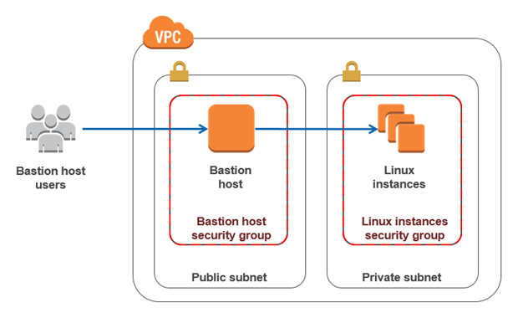
Bastion Host: is a special-purpose server designed to provide secure access to a private network, especially for administrative tasks. It acts as a gateway for managing resources in private subnets or isolated environments, ensuring that sensitive systems remain inaccessible from the public internet.
Acts as the only entry point to the private network for administrators.
Typically accessible via Secure Shell (SSH) or Remote Desktop Protocol (RDP).
Resides in a public subnet of a Virtual Private Cloud (VPC).
Provides access to resources in private subnets without exposing them to the internet.

Slide 65
Scenario: You have an application architecture where the web servers are in a public subnet, and the database servers are in a private subnet to ensure they are not directly accessible from the internet.
Solution: Deploy a bastion host in the public subnet to securely access the database servers for administrative tasks like database updates, troubleshooting, or backups.

Slide 66

Network Address Translation (NAT) in AWS is a mechanism that allows instances in private subnets of a Virtual Private Cloud (VPC) to access the internet or other AWS services without exposing those instances to incoming traffic from external sources. This is essential for maintaining security while enabling outbound communication.
AWS-managed NAT, higher bandwidth, high availability, no administration
Pay per hour for usage and bandwidth
NATGW is created in a specific Availability Zone, uses an Elastic IP
Requires an IGW (Private Subnet => NATGW => IGW)
No Security Groups to manage / required

Slide 67
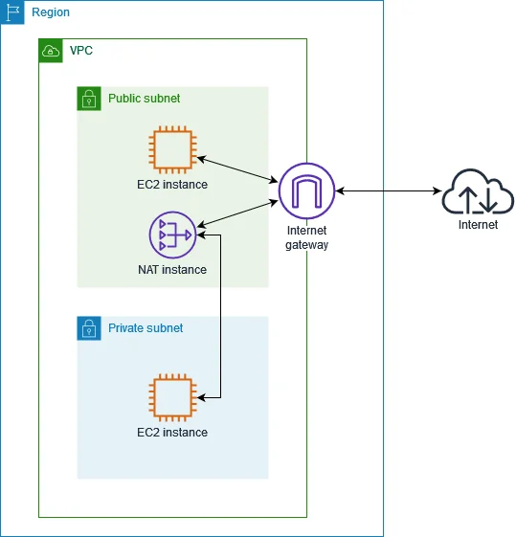
Deployment Steps for NAT Gateway
1. Create a Public Subnet:
Ensure it has a route to the internet via an Internet Gateway.
2. Create a NAT Gateway:
Go to the AWS Management Console → VPC → NAT Gateway.
Assign it to a public subnet and associate an Elastic IP.
3. Update Route Table:
Select the private subnet’s route table.
Add a route directing 0.0.0.0/0 (all internet traffic) to the NAT Gateway.

Slide 68
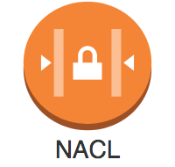
Network Access Control Lists (NACLs) in AWS are a layer of security for your Virtual Private Cloud (VPC). They function as a firewall to control inbound and outbound traffic at the subnet level. NACLs operate alongside security groups to provide additional traffic filtering capabilities.
Subnet-Level Control:
NACLs are attached to subnets and control traffic for all instances within that subnet.
Stateless:
NACLs are stateless, meaning responses to allowed inbound traffic must explicitly be allowed in the outbound rules and vice versa.

Slide 69
Rules Evaluation:
Rules are evaluated in order (from the lowest to highest rule number), Rule number (0 to 32,766).
Each rule can either allow or deny traffic.
If no rules match, traffic is denied by default.
When you see a rule number listed as *, it represents the default implicit deny rule.
This rule automatically blocks any traffic that doesn't explicitly match any of the other rules in the NACL
Rule Components:
Rule Number: Determines the order in which rules are evaluated (from lowest to highest).
Protocol: Specifies the protocol (e.g., TCP, UDP, ICMP).
Port Range: Defines the range of ports for the traffic.
CIDR Block: Specifies the source or destination IP address range.
Allow/Deny: Indicates whether traffic is permitted or denied.
Default vs. Custom NACLs:
Every VPC comes with a default NACL that allows all inbound and outbound traffic.
Custom NACLs deny all traffic by default until explicitly allowed

Slide 70
Use Cases for NACLs
Blocking IP Ranges: Deny traffic from specific IP ranges or geographic regions.
Restricting Access: Enforce subnet-level access control in addition to security groups.
Layered Security: Use NACLs to add an extra layer of defense to your security architecture.
Differences: NACLs vs. Security Groups
Feature | NACL | Security Group
Scope | Subnet-level | Instance-level
State | Stateless | Stateful
Inbound/Outbound | Rules must be configured for both | Automatically tracks connections
Rule Action | Allow or Deny | Allow only
Evaluation Order | Numerical order | All rules evaluated collectively

Slide 71
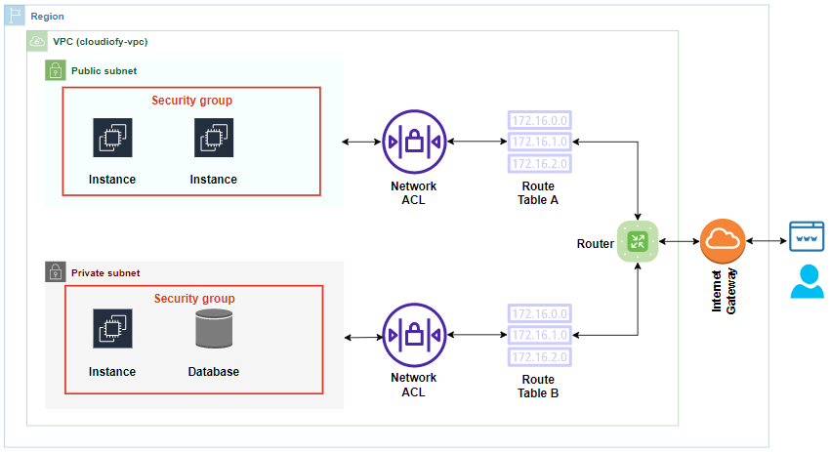

Slide 72
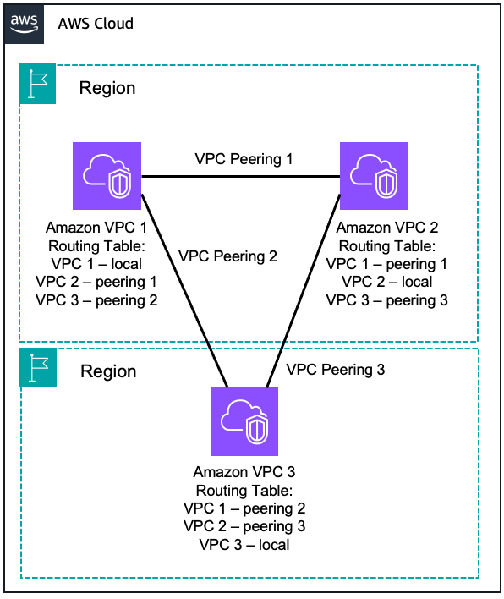
What is VPC Peering?
VPC Peering in AWS is a networking connection that allows you to route traffic between two Virtual Private Clouds (VPCs). This enables the instances in the VPCs to communicate as if they were in the same network.
Private Connectivity: Traffic between the VPCs stays within the AWS backbone, ensuring secure and low-latency communication.
Cross-Region Support: You can create VPC peering connections across regions (known as inter-region VPC peering).
No Overlapping CIDR Blocks: The CIDR blocks of the VPCs must not overlap for a peering connection to work.
One-to-One Relationship: VPC peering is non-transitive, meaning you need to establish a direct peering connection between each pair of VPCs you want to connect.

Slide 73
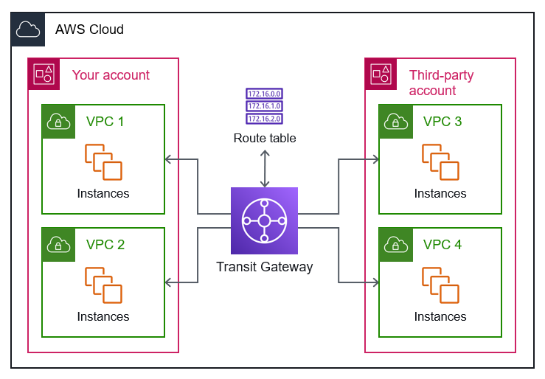
What is a Transit Gateway in AWS…?
Transit Gateway (TGW) is a highly scalable, centralized networking hub that connects multiple Amazon VPCs, on-premises networks, and AWS services. It simplifies complex network architectures by acting as a single routing point for interconnecting networks.

Slide 74
